Slide 1
Creating a Paper Report
Notes:
Schedule: Timing Topic
<xx> minutes Lecture
<xx> minutes Practice
<xx> minutes Total

Slide 2
Objectives
After completing this lesson, you should be able to do the following:
  Create a simple tabular paper report using the Report Wizard
  Describe the methods of building the report query
  Summarize report values
  Modify the style and content of a report
  Create other report styles available in the Report Wizard

Slide 3
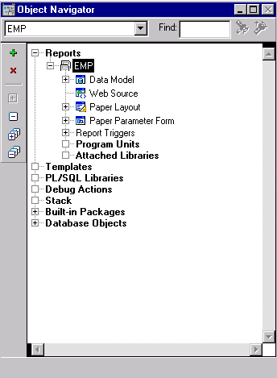
Report Module Components
  Data Model
  Web Source
  Paper Layout
  Paper Parameter Form
  Program Units

Slide 4
Building a Paper Report
You have two options:
  Use Reports Builder
    Wizards
    Paper Layout
    Paper Design
  Define the report in XML

Slide 5
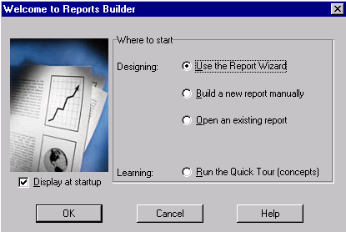
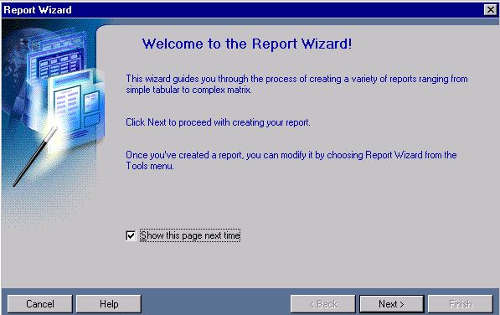
Invoking the Report Wizard

Slide 6
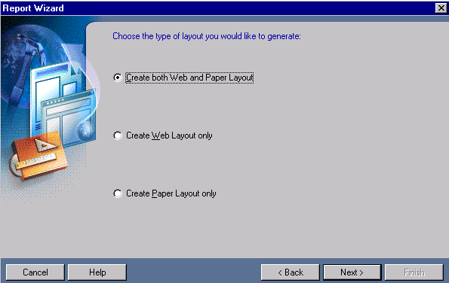
Choosing the Layout Type

Slide 7
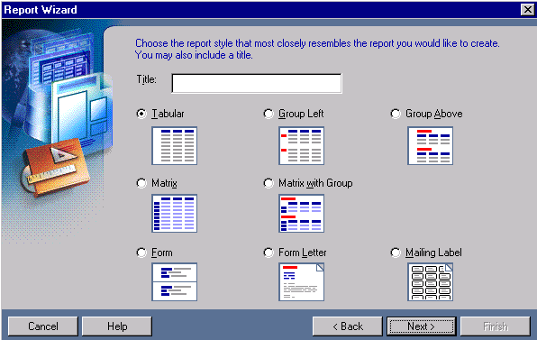
Creating a Tabular Report
Wizard Pages
  Report Style
  Data Source
  Type
  Data Source
  Definition
  Fields
  Totals
  Labels
  Template

Slide 8
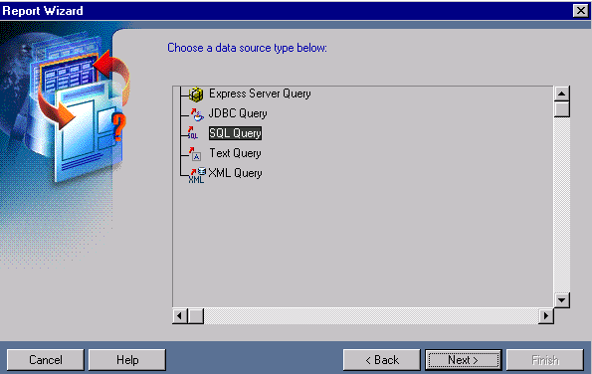
Selecting the Data Source Type

Slide 9
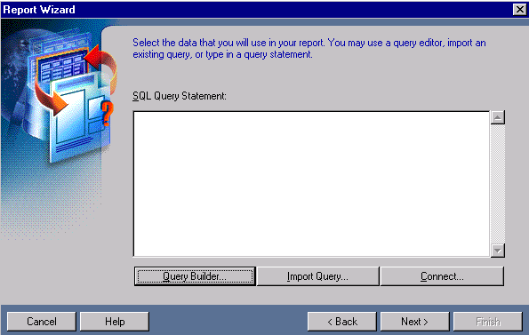
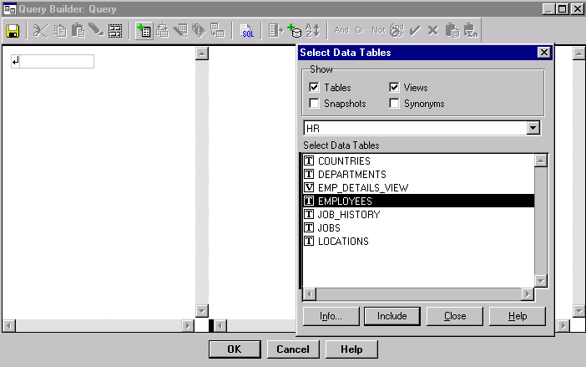
Using Query Builder

Slide 10

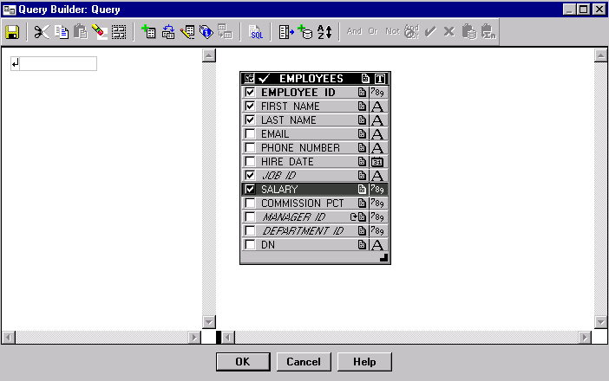
Building a Query

Slide 11
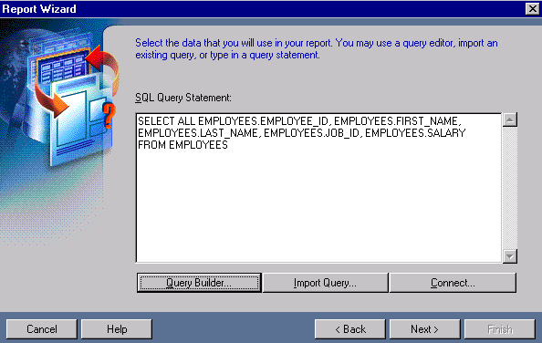
Building a Query

Slide 12
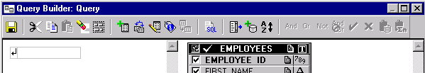
Query Builder Functions
  User-friendly interface: Alternative to writing SQL
  syntax
1
2
3
4
6
5

Slide 13
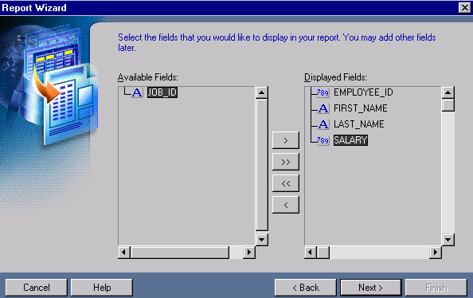
Selecting Displayed Fields

Slide 14
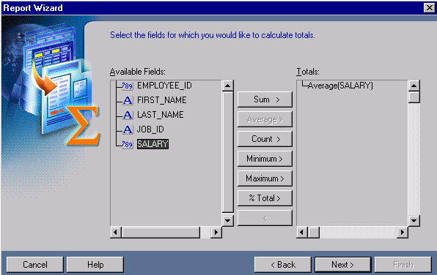
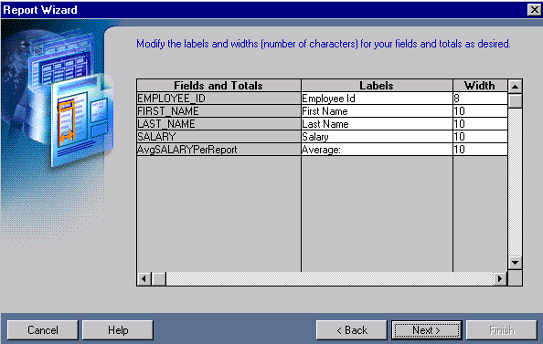
Totals and Labels

Slide 15
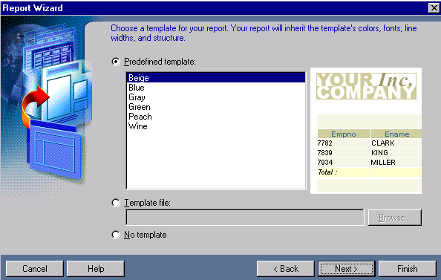
Selecting a Report Template
  Enforce corporate standards
  Create professional-looking paper reports easily

Slide 16
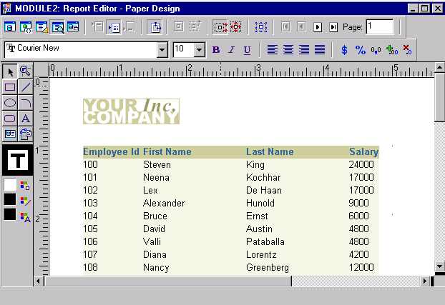
Viewing the Paper Report Output
2
1

Slide 17

Saving the Report Definition
Save changes frequently.
File > Save
File > Save As...
xxx.rdf
yyy.rdf

Slide 18
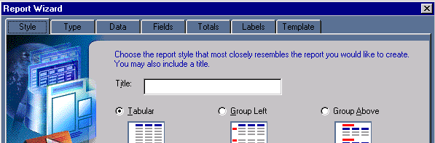
Reentering the Wizard
  Select Tools > Report Wizard.
  Tabs are different for each report style.
  Wizard preserves all previous settings.

Slide 19
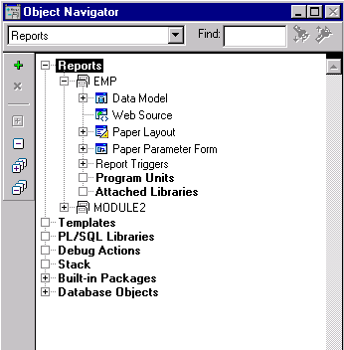
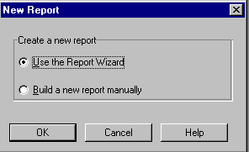
Creating a New Report
2
1

Slide 20
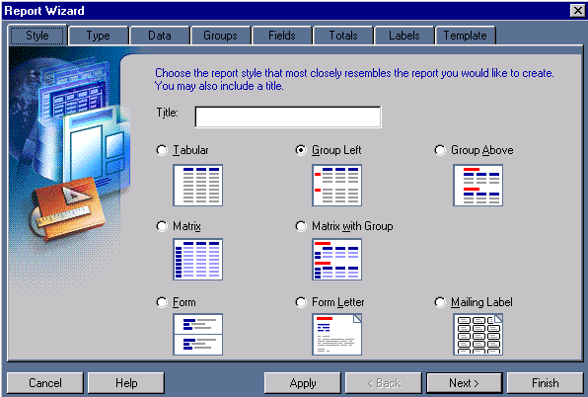
Creating Break Reports
  Break report styles:
    Group Left, Group Above
  Additional
  wizard page:
    Groups

Slide 21
Break Report Labels
Group Left
Location Id Department Name Last Name Job Id
xxxx
xxxxxx
xxxx xxxxx xxxxxxx xxxx
Group Above
Location Id xxxx
Department Name xxxxxx
Last Name Job Id
xxxx xxxxx
xxxxxxx xxxx

Slide 22
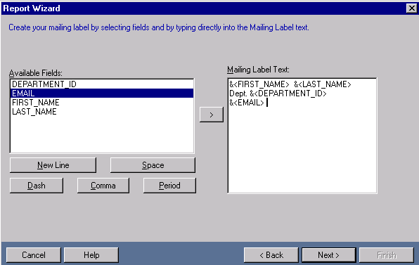
Creating Mailing Labels and Letters
Wizard pages:
  Style
  Data
  Text
  Template

Slide 23
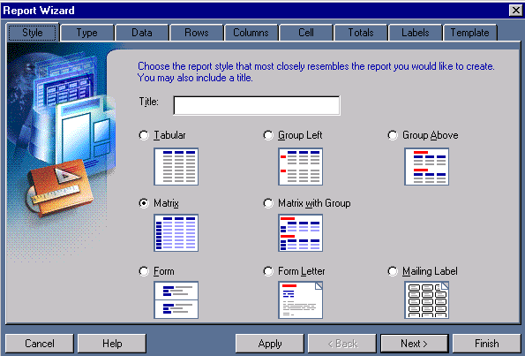
Creating a Matrix Report
Three additional wizard pages:
  Matrix rows
  Matrix columns
  Matrix cells

Slide 24
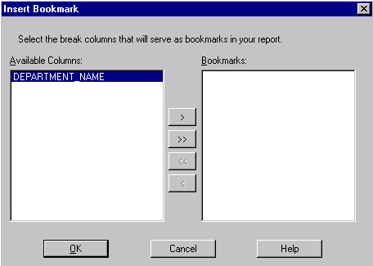
Previewing a Paper Report in a Browser
  Use Insert > Bookmark to create a bookmark for your break report
  Use File > Generate to File

Slide 25
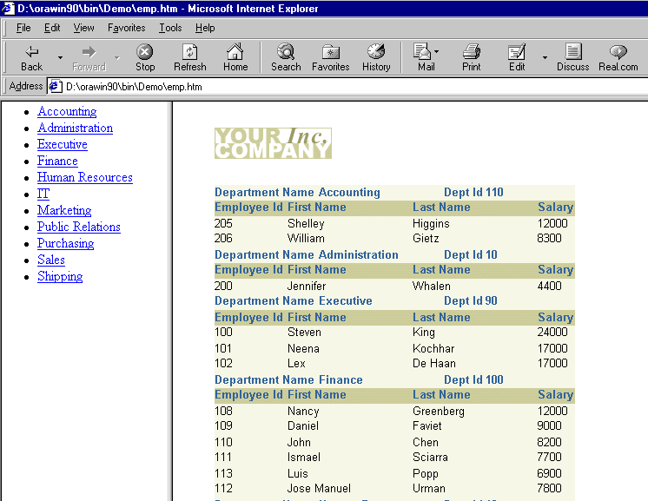
Previewing a Paper Report in a Browser

Slide 26
Summary
  In this lesson, you should have learned how to:
  Create paper reports with the Report Wizard
  Build queries using the Query Builder
  Apply templates to paper reports
  Modify reports by reentering the wizard
  Create new reports of different styles
  Preview a paper report on the Web

Slide 27
Practice 4 Overview
  Creating a Tabular report
  Modifying the report to create a Group Above break report
  Creating a Form Letter
  Creating a Matrix report
  Creating a Matrix with Group report

